Slide 1
ECE249
UNIT-2
Lecture 2

Slide 2
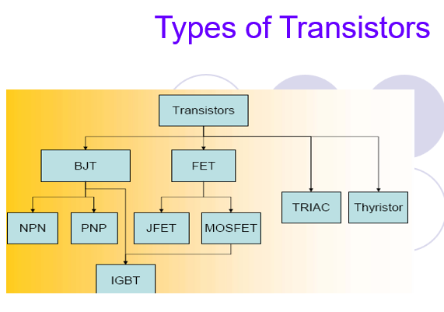

Slide 3
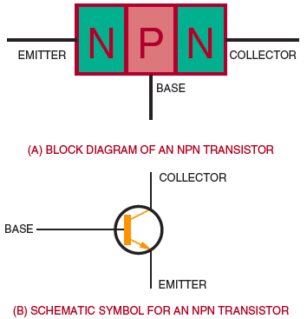
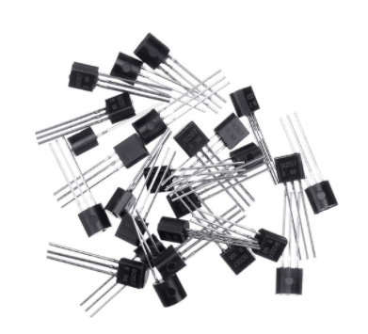
Transistor Construction
Figure NPN transistor.

Slide 4
Emitter is ................. Doped
QUIZ POLL
heavily
lightly
Medium
All of the above

Slide 5
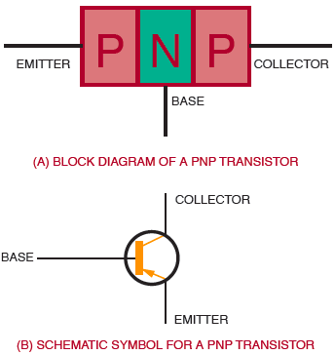
Figure PNP transistor.

Slide 6
Emitter is ................. Doped
QUIZ POLL
heavily
lightly
Medium
All of the above

Slide 7
In a pnp transistor, the current carriers are ………….
acceptor ions
donor ions
free electrons
holes

Slide 8
In a npn transistor, ……………. are the minority carriers
free electrons
holes
donor ions
acceptor ions

Slide 9
Collector has ............... size among all terminals in BJT
QUIZ POLL
least size
Medium
biggest
All of the above

Slide 10
The element that has the smallest size in a transistor is ………………..
QUIZ POLL
collector
base
emitter
collector-base-junction

Slide 11
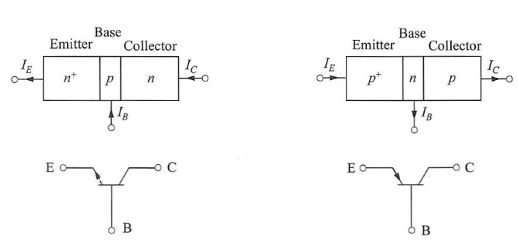
BIPOLAR JUNCTION TRANSITOR (BJT)
Transistor is a solid state device
It is a current controlled device
It has three terminals
Emitter
Base
Collector
There are two types of Transistor
PNP
NPN
Doping of Terminals
Emitter- highly doped
Base- Lightly doped
Collector- Moderately doped

Slide 12
Transistor wrt Vaccum Triode
Advantages
Compact Size
Light weight
Rugged Construction
Resistive to shock and vibration
Instantaneous operation
High operation point
Long life
No aging effect
Disadvantages
Loud hum noise
Restricted operation up to 75 degree
Operating frequency – Few MHz

Slide 13
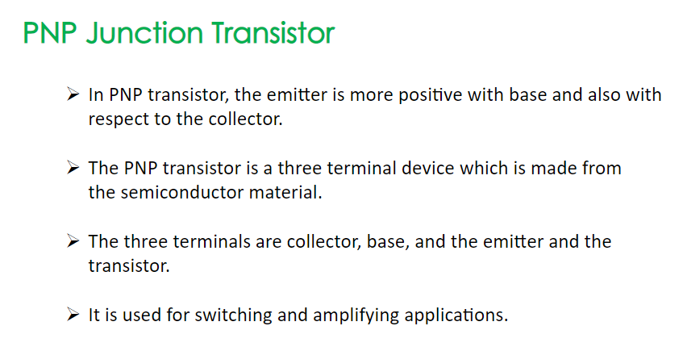

Slide 14
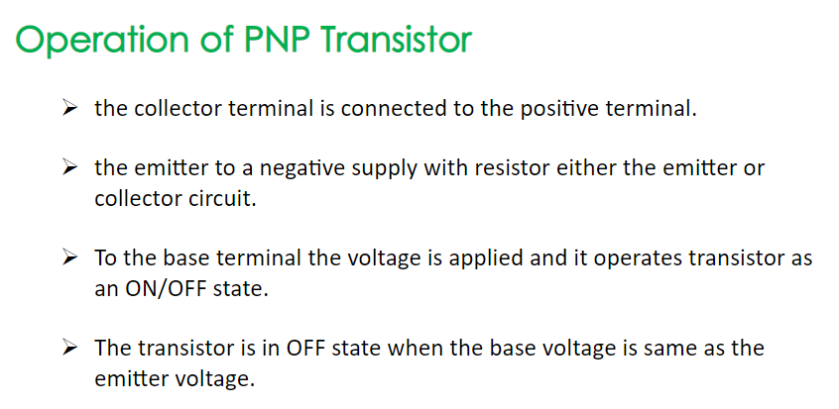

Slide 15
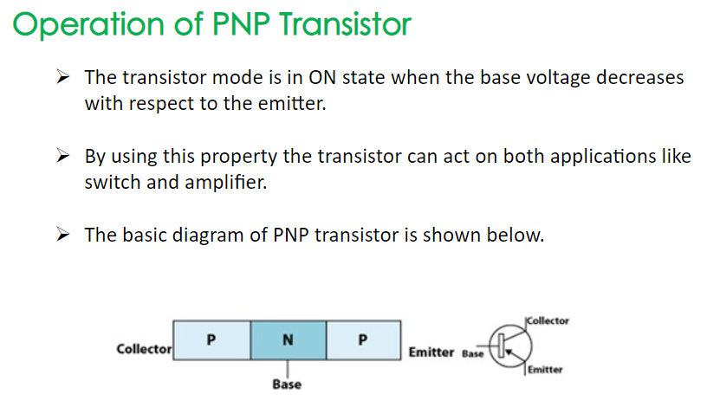

Slide 16
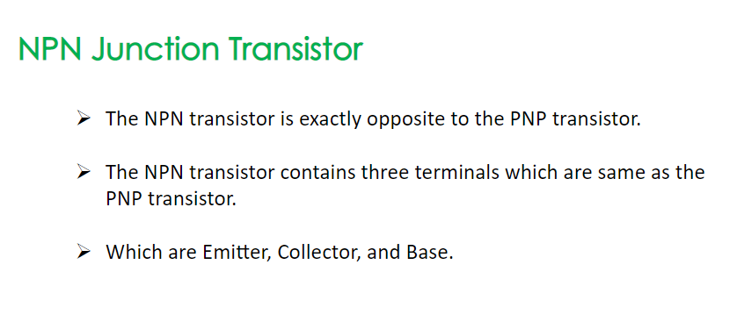

Slide 17
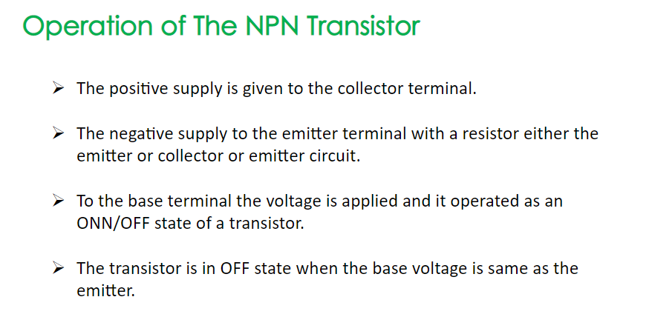

Slide 18
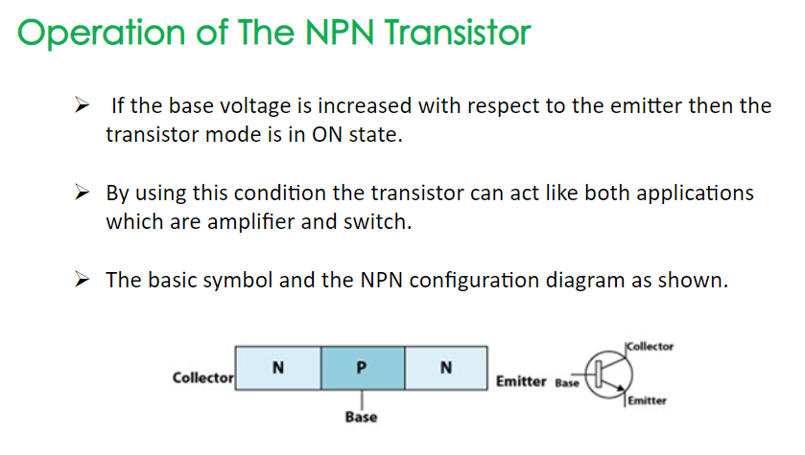

Slide 19
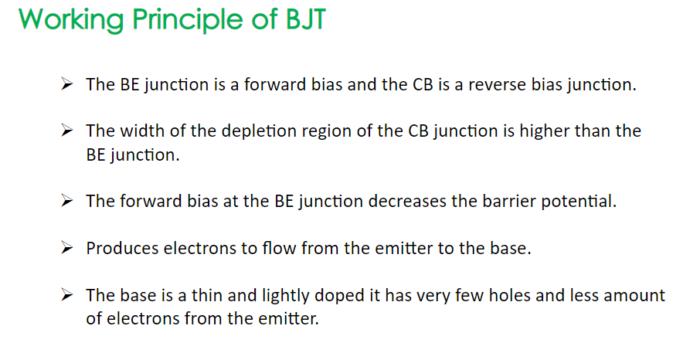

Slide 20
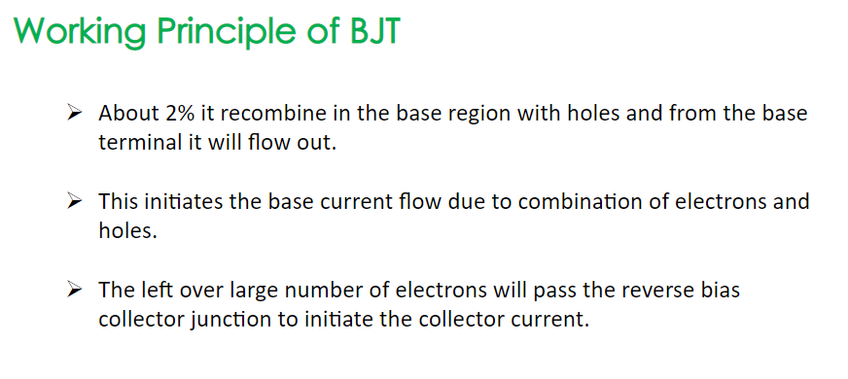

Slide 21
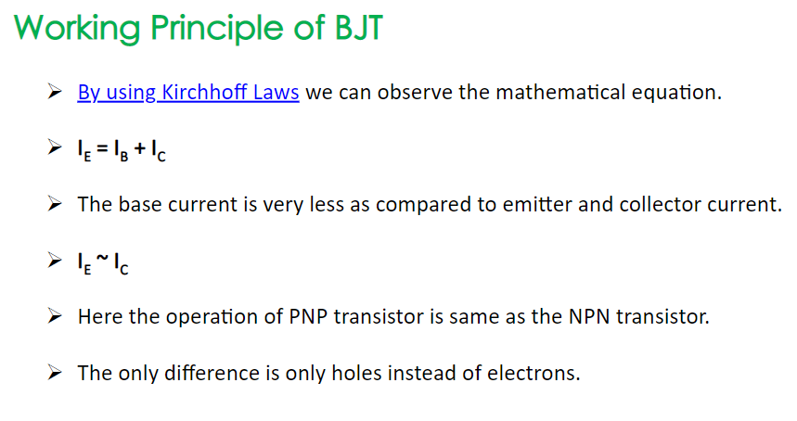

Slide 22
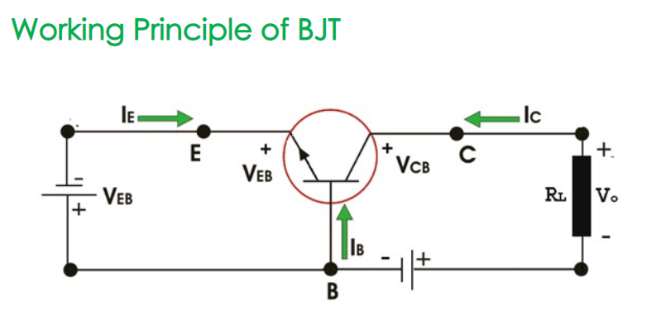

Slide 23

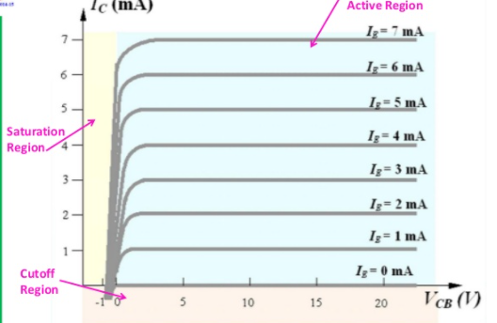
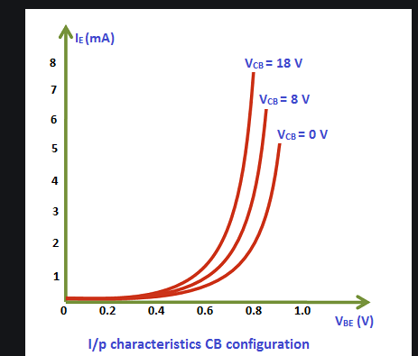

Slide 24
At the emitter base junctions of a transistor, one finds………….
A reverse bias
A wide depletion layer
Low resistance
Both a and b

Slide 25
Most of the majority carriers from the emitter……………
Most of the majority carriers from the emitter……………
QUIZ POLL
Recombine in the base
Recombine in the emitter
Pass through the base region to collector
Both a and b
Both b and c
Recombine in the base
Recombine in the emitter
Pass through the base region to collector
Both a and b
Both b and c

Slide 26
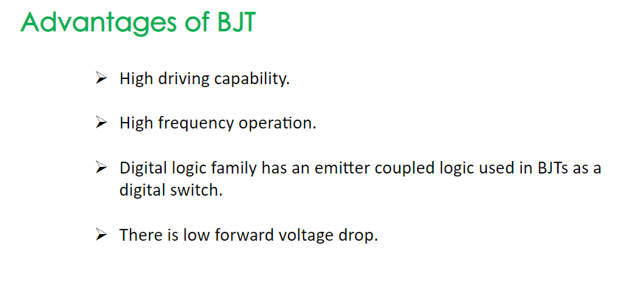

Slide 27
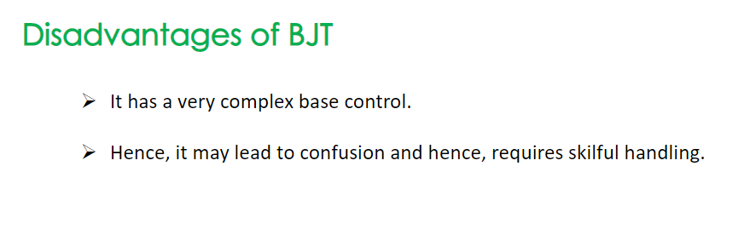

Slide 28
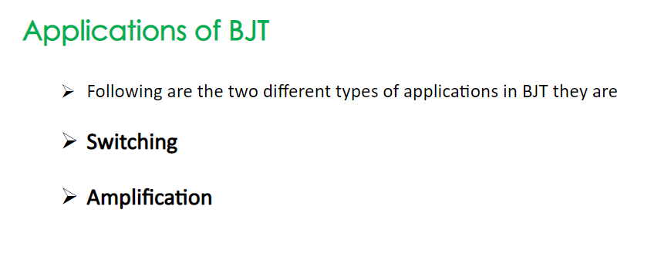

Slide 29
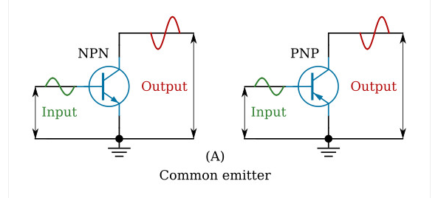

Slide 30
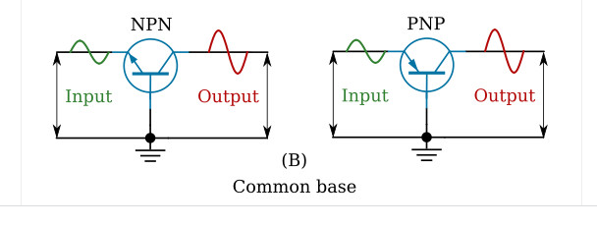

Slide 31
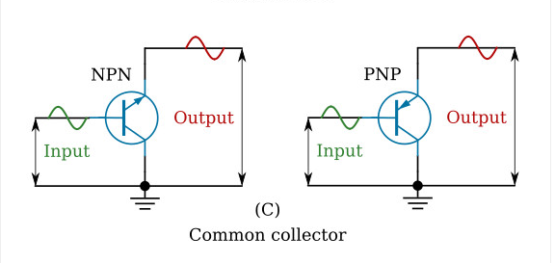

Slide 32
